Slide 1

SWEN-755: Software Architecture
Lecture 1: Intro to the course and software requirements and architecture
Viktoria Koscinski

Slide 2
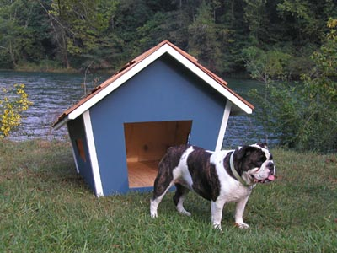
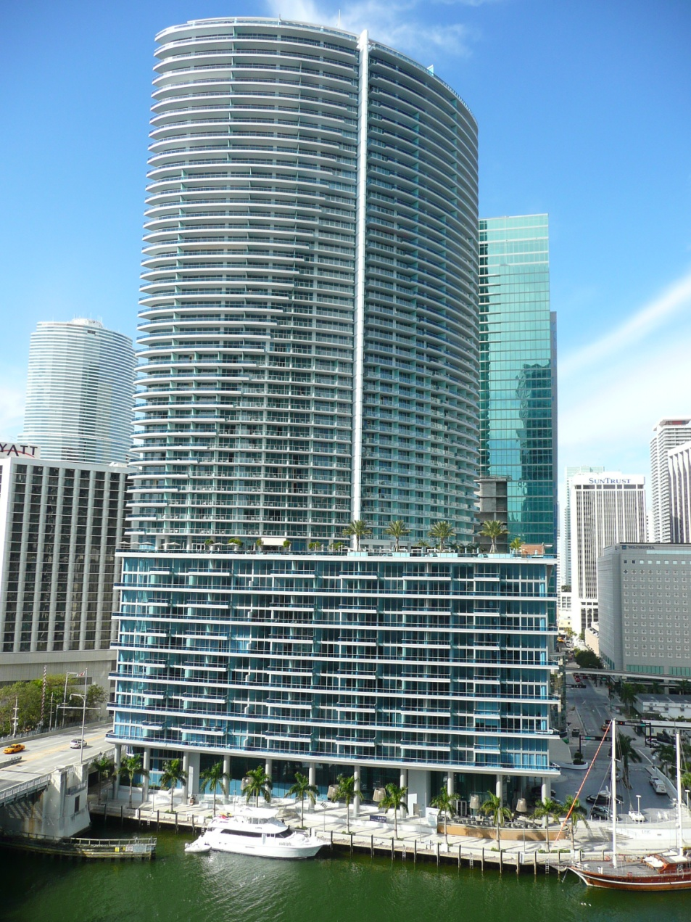

From dog houses to sky scrapers…

Slide 3
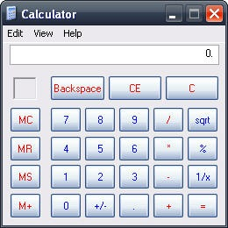
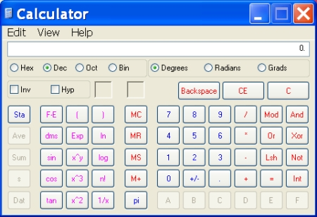

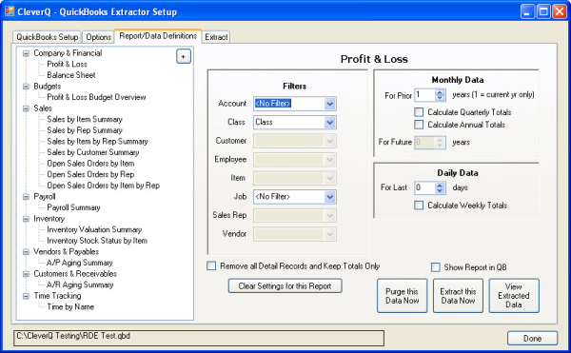
From dog houses to sky scrapers…

Slide 4


What is architecture?
“The software architecture of a system is the set of structures needed to reason about the system, which comprise software elements, relations among them, and properties of both.”
Structure and Vision
Structures – a set of elements and relationships among them
View – a representation of architectural elements (representation of one or more structures)
Notes:
Photos: structure and vision

Slide 5
Requirements
What the system should do and not do
Functional capabilities derived from user needs
Non-functional refers to software qualities such as reliability, availability, performance, security and many other dependability attributes
Constraints or conditions imposed by the external environment; e.g., budget, schedule, standards, laws, or legacy systems
Notes:
The System’s “What” not the “How”

Slide 6
Requirements (example)
Functional requirements: system’s functionality
“The system shall prompt the user for confirmation upon a user-requested ‘save’ action”
Non-functional requirements: system’s quality attributes (security, performance, availability, etc.)
“The system shall utilize a password-based authentication mechanism”
Notes:
What type of non-functional requirement is the one on the bottom? Security.

Slide 7
Different types of requirements
One way to categorize requirements: FURPS+
Functionality
Usability
Reliability
Performance
Supportability
“+”
Design constraints
Implementation requirements
Interface requirements
Physical requirements
Security requirements
…
The primary, but not the only, type of requirements
Quality attributes (“-ilities”)
Non-functional
Requirements

Slide 8

Requirements and Architecture
How the system does what it does is architectural
To Understand what the system does
Customers
and End Users
Requirements
and Qualities
Business
Owners
Architecture
Req. Engineer
Architect
System
Technical Environment
Architect’s Experience
conditions imposed by the external environment; e.g., budget, schedule, standards, laws, or legacy systems

Slide 9
Course overview
Requirements
- Understanding stakeholders’ needs
- Feasibility Analysis
- Documentation
Architecture Design (High Level)
- Making strategic design decisions
- Skeleton of software
- Trade-off & risk analysis
Implementation
- Coding
- Testing
Maintenance
- Change request
- Impact analysis
- Documentation
Low Level Design
- Transition from architecture to code
- Class diagram
- Design patterns

Slide 10
Course overview
Focus on requirements
Architecturally significant requirements (ASRs)
Software architecture (transition from requirements)
Functional architecture to address functional requirements
Architectural tactics and styles to address quality requirements
Project to better understand architecture
Architectural failures and the importance of architecture
Product Line Design

Slide 11
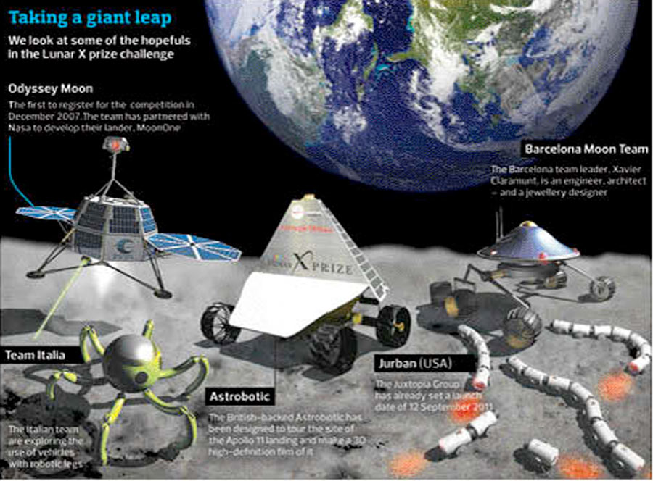
Let’s look at an example
Lunar Robot: Mini Requirements-Architecture

Slide 12



Mini Requirements Architecture
Scientists (users in this example):
Function on moon surface to
collect samples,
send data and photos, run experiments…
Requirements Engineers:
Lunar Robot Route Traversal:
The LR shall have the ability to move to a new location.
The LR shall have a maximum speed of max speed.
The LR shall detect and avoid obstacles in its path.
The LR shall map obstacles that it encounters.
Science Functions:
The Robot shall retrieve soil samples.
The Robot shall have the capability to perform scientific tests on the retrieved samples.
Non-Functional Requirements (Qualities):
The Robot shall have a probability of uncorrectable failure of less than 0.001 during its mission on the surface of the moon.
Business Owners:
Perform scientific experiments on the moon, successfully

Slide 13
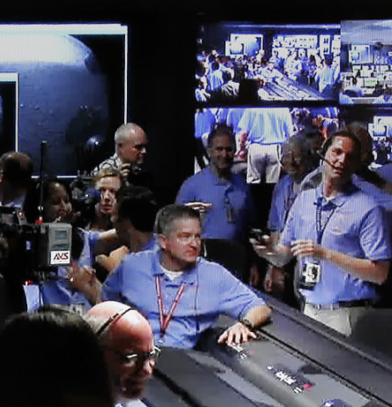
Mini Requirements Architecture
Software Architecture:
Collection of components/modules.
Functional requirements to decompose the system into subsystems and modules.
During implementation these modules are the packages in your program.
Use of layers to increase modifiability and integration of a new component.
Lunar Robot Control System
Integrated Vehicle Health Management System
Navigation Domain
Guidance Domain
Control Domain
Short Time Scale IVHM
Fault Detection
Isolation Identification
Redundancy Management
System
NAV
D-Exec
CNC
Actuators Robust Regulators
Logger
HW/SW Config-Mgm
NVR
GMP
CNE
GDL
Sensors Dedicated Tests
Sensor Selection
Control System Coordinator
Path Planning
CHM
NHM
GHM
D-Exec
Watch-Dog
Simulation Engine
Self-Recovery
D-Exec
Robot Executive
Task Sequencer
Operators’ Command & Data Processing
Notes:
Image example: decomposing the system into modules

Slide 14
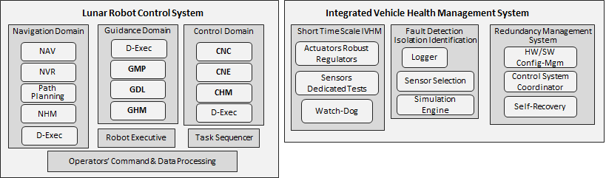
Mini Requirements Architecture
Software Architecture:
Architecture is about how components interact with each other.
Replicate DataBus to enhance reliability and availability requirements.
GPS Receivers
GPS Receivers
Communication
System
Lunar Robot
Control System
GPS Receivers
GPS Receivers
Triple-Redundancy System with Graceful Degradation
GPS Receivers
GPS Receivers
GPS Receivers
Rate
Gyros
Integrated Vehicle Health Management System
Bus(s)
Integrated Health Management System
.
.
.
.
.
Multiple Fault Tolerant Flight Computer with integrated health monitoring and telemetry
Power Management System
GPS Receivers
Power Management System
GPS Receivers
Engines & Actuators Interface

Slide 15
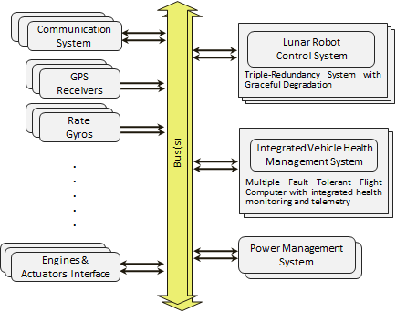
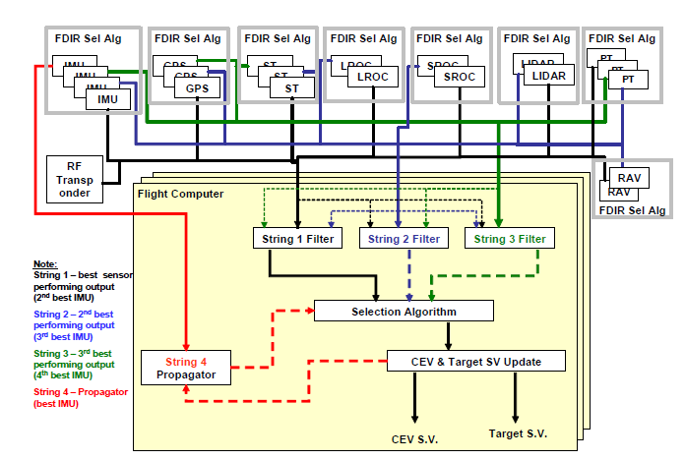
Mini Requirements Architecture
Software Architecture:
Use of architectural styles and patterns that satisfy availability concern of failure of less than 0.001. Fault detection through the “Heartbeat” tactic, and recovery through replication and voting.

Slide 16
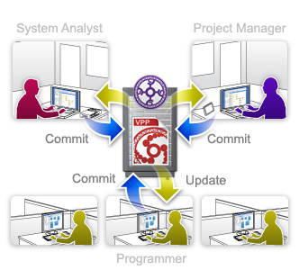

Mini Requirements Architecture
Software Architect:
Uses appropriate technologies to design the system, platforms, libraries, databases, servers etc.
Assigns critical requirements to the teams with the relevant expertise.

Slide 17
This Course
Grading:
Class Activities and Participation 10 %
Quizzes 20 %
Assignments 20 %
Mid-term Exam 20 %
Final Research Project 30 %
MyCourses will have dropbox for assignments, etc.
Notes:
Class activities – not assessments
Quizzes – assess your knowledge
Assignments – primarily group assignments; I will let you choose your own group of 3 people, BUT no complaining about your teammates; each assignment will have a short presentation/demo
Final project – group

Slide 18
This Course
Participation:
Participation does not mean just attendance.
Attendance will periodically be taken, but you are expected to be present in all the class sessions.
Project Participation:
Students are expected to actively contribute in team projects. Peer evaluations will be performed.
A grade of ‘zero’ may be assigned to any student who is clearly not engaged with their project team
Attendance:
You have one unexcused absence with no consequences. After that, the following scale applies for additional absences: 1% off final grade for each additional unexcused absence, up to 5% off your class activities and participation score.
Send me an email if you know you will miss a class.
Notes:
Students wishing to receive full credit for class participation must participate in project team meetings, complete quizzes and assignments on time, and contribute to the learning process in the classroom in a positive way.
An individual’s project grade can increase or decrease based on peer evaluations and instructor observations
Please keep in mind that if you miss many classes, even though only up to 5% will be taken off for attendance, it is likely that you will also have lower scores overall due to missed class activities, quizzes, or exams. Excused absences include documented illness, family emergencies, job interviews, or academic/school-related activities such as participation in a conference or an athletic team event. Contact the instructor as soon as possible: if you know you will miss a class.

Slide 19
Research Project
Explore software architecture in the real world
Work in team
Importance and application of architecture
Research
Assess existing tools and techniques
Present
Impart knowledge
Solicit discussion
Notes:
Project will focus on analyzing recent or impactful architectural failures and why/how they occurred.
Some flexibility for a “choose your own adventure” project, where you can do your own preferred project topic. However, this will require some extra preparation and approval in advance.

